Slide 1
ANC18 - Predicting Patient Experience
Notes:
Would like to note some my current initiatives. Last year we implemented Caboodle and this year we are vetting and extending the subject areas and making the data available to business users. One the ways is through self-service reporting using Qlik Sense. So we are also setting up Qlik Sense data models for different subject areas. Also, helping with our quality initiatives. If you have common initiatives, look me up and let’s trade stories.

Slide 2


Notes:
St Elizabeth Healthcare is one of the largest medical organizations on the Greater Cincinnati area with seven facilities in northern Kentucky. We are proud to have 3 magnet hospitals. Our mission is to provide comprehensive and compassionate care to improve the health of the people we serve.

Slide 3

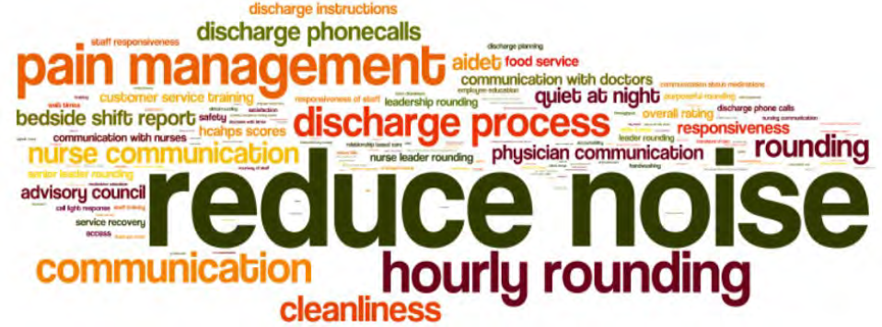
The Patient Experience Challenge
Notes:
And of course a very important part of this is The Patient Experience which I know is important to your organization.
One of the challenges we have are the number of factors that can influence the experience including provider communication, quality of facilities, encounters, social factors, etc. The challenge in improving the patient experience is understanding which factors are most important. These factors can vary by facility, by patient type and by encounter.

Slide 4

HCAHPS Surveys
Standardized inpatient survey covering hospital experience:
Communications with doctors and nurses
Responsiveness of staff
Pain management
Quietness
Communications about new medications
Discharge information
Cleanliness
Care transition
Notes:
For this study we concentrated on inpatient experience using the HCAHPS survey results. The survey covers eight key topics.
We concentrate most on how patients rate the overall experience.

Slide 5
HCAHPS Is Important
Public reporting of data to increase transparency.
Enables comparisons to support consumer choice.
Part of the basis for Value Based Purchasing payments from CMS.
Typically part of incentive programs
Notes:
The surveys are important as they are required by CMS (as part of Value Based Purchasing Payments), are publicly available, support consumer choice, and are often used incentive programs.
For St Elizabeth it is part of all associates incentives.

Slide 6
HCAHPS Is Important
Listening to patients is important: Patients are credible sources for accessing quality of care.
Notes:
And of course, Listening to Patients is the right thing to do. The are credible sources for accessing quality of care.

Slide 7
Survey Analysis Benefits
Identify the important factors:
“How does Teamwork affect the overall rating?”
Predict ratings:
“Which patients in our unit are not likely to have a good experience?”
Problem areas and areas of excellence:
“Which procedures affect the overall rating?”
Notes:
Analysis of surveys can help in several ways
Predictive analytics can help in the understanding the factors that most influence the patient experience. This identifies areas for improvement, education and patient interaction.
Data which is available before the patient is discharged can also be used in rounding to concentrate on patients likely to not have a good experience.
Also specific factors can be analyzed for impact on scores.

Slide 8

R Project
Comprehensive R Archive Network at:
http://cran.r-project.org
Notes:
We used the R Project for predictive models. I should also mention are finding Qlik Sense very helpful once we know the important factors.
R is a language for data mining and statistical analysis.. It’s freely available and supported by a large and active worldwide research community.
But there are many popular statistical and graphing packages available (such as SAS or SPSS).
If new to R, recommend R in Action.

Slide 9
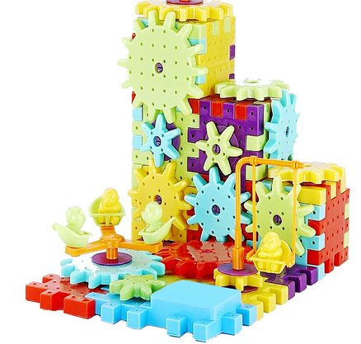
Predictive Models
Training Survey Data
Model
Predictor: Age
Build
Predictor: Facility
Response: Overall Rating
Model
Test Survey Data
Predict
Predictor: Age
Response: Overall Rating
Predictor: Facility
Notes:
So if you are familiar with predictive models you input a predictor (like a demographic) and the model produces a predicted response. You actually develop the model with a training set of data where is knows the response and then use it in predict mode with test data.
So much of the study tried different predictive models, different predictors, different responses to see how well they performed. They were evaluated on well they predicted.

Slide 10
Model Development & Evaluation
Predictors evaluated:
Detailed survey questions
Demographics, social history
Encounters, procedures, diagnosis, flow sheets
Billing
Providers
Models evaluated:
Binary Logistic Regression
Ordinal Logistic Regression
Decision Trees
Random Forrest
Naïve Bayes
Responses evaluated:
Overall rating (0 – 10)
Rankings of overall rating (good/not good)
Detailed survey ratings
Notes:
So if you are familiar with predictive models you input a predictor (like a demographic) and the model produces a predicted response. You actually develop the model with a training set of data where is knows the response and then use it in predict mode with test data.
So much of the study tried different predictive models, different predictors, different responses to see how well they performed. They were evaluated on well they predicted.

Slide 11
Best Process
Wrangle the Data:
Clean, conform and join
Create response from ratings (good or not good).
Binary Logistic Regression:
Develop models for each predictor
Best correlation coefficient
Coefficient should be significant
Test Prediction
Test each predictor
Best area under ROC curve (AUC)
Notes:
This is the process that gave us the best results. Of course you need to get you data in shape and create different kinds of responses.
Binary Logistic Regression gave us the best results. We tried each predictor individually and ranked then according to the correlation coefficient which can be thought of as a measure of the odds with will affect the score.
Then try each predictor on test data to see how well it predicts. We use the area under the ROC (receiver operator characteristic) curve to evaluate. Can think of it as the probably of a positive response is chosen over a negative response – but more on this later.
http://www.dataschool.io/roc-curves-and-auc-explained/

Slide 12
Best Process
4. Best Combinations of Predictors
Choose best predictors
Test with Multi Binary Logistic Regression
Test prediction
5. Explore Best Combinations
Decision trees provide a deeper understanding of the predictors.
6. Try Different Responses
Repeat process with responses
Best prediction with “good” >= 8
Notes:
So now we have rankings for all the predictors but combinations of predictors can be used. This can take a long time manually. So we choose the best (correlation & auc) and let a Multi Binary LM choose the best.
Once we have these we can use a decision tree to gain more insight into the predictors.
And try different responses. The one that works best for us is classifying good scores as 8 or greater and 7 or lower as not good.

Slide 13
Best HCAHPS Survey Predictors
Description | AUC
Nurses treat with courtesy, respect | 78
Nurses Listen | 78
Nurses explain | 76
Help soon for call button | 76
Healthcare needs when leaving | 76
Understand medication purpose | 76
Understanding when leaving | 71
Bathroom clean | 69
Help with pain | 69
Doctors listen | 68
Doctors explain | 68
Pain controlled | 67
Notes:
We used detailed HCAHPS survey questions to predict the overall score question. This uses the prediction area on the curve to rank. Can think of it as the probably of a true response is chosen over a false response. So 50 would mean you are randomly guessing and 100 means you predict perfectly.
Can see the importance of nursing in the patient experience which is intuitive to those in our organization who work on improving the experience.

Slide 14
Best PRC Loyalty Predictors
Description | AUC
Recommend to friends | 88
Overall quality of care | 84
Teamwork | 83
Nurses understanding, caring | 80
Nurses explain treatment | 80
Nurse promptness | 79
Nurse communication | 77
Level of safety | 77
Rate discharge process | 77
Doctors explain treatment | 76
Doctors decisions in care | 76
Doctors discussing anxiety | 76
Notes:
Our surveys are conducted by PRC and they add additional loyalty questions so we also used those to understand predictors of the overall score. The nursing results line up with the HCAHPS questions, but some of their questions are even stronger – See teamwork.
So these are interesting as you can look at the very important predictors and look at the score for you organization and if it not where you want it, there’s an opportunity.
This is good information but of great interest is finding predictors in our data while the patient is in the facility. And this is the challenging part in studying the patient experience. As we saw on previous predictors the patient experience is greatly affected by teamwork, nurse communication, etc. and this kind of data is not typically found in our data.

Slide 15
Best In-Facility Data Predictors
Predictor | Summary | Increased Odds of Lower Rating
Admission Type | Emergency or Urgent lowers rating | 100%
Pain Level | Higher level lowers rating | 30-60%
ICU | ICU lowers rating | 36%
Service Line | Raise or lowers rating | -25% - 50%
Age Group | Under 55 lowers rating | 27%
Marital Status | Some lower rating | 20%
Tobacco Use | Lowers rating | 13%
AUC: 62
Notes:
But these turned out to be good predictors for us. A combination of demographics, the provider, the facility, and whether it was an ICU visit.

Slide 16

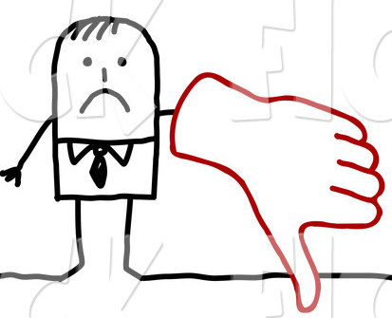
Best In-Facility Data Predictors
On average 10% give low rating.
Notes:
Here’s an example. On the average we know 10% will give a low score so in our unit of 20 we will have a low score from 2.
Let’s say we want to try to identify these patients to review their situation and talk to them.

Slide 17
Best In-Facility Data Predictors
Randomly pick half, we will find half of the low ratings.
Notes:
If we wanted to identify the patients likely to give us a low score we could randomly pick half (10) and we would be likely to identify half (1).

Slide 18
Best In-Facility Data Predictors
Model chooses 25% and correctly finds half of low ratings.
Average rating of chosen is 8.5
Notes:
But using the binary logistic model with the in-facility demographic, provider & facility data, the model chooses 25% and of those, it correctly identifies half. The chosen have an average sore of 8.5. So its pretty good.

Slide 19
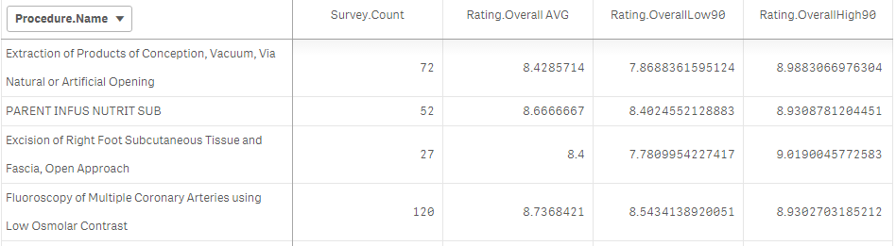
Predictors with Many Levels
Predictors with many levels may not be useful with regression models.
Use confidence interval for sample mean
Notes:
Some predictors have many levels and these don’t work well with regression models. For example, there are lots of diagnosis and lots of procedures. But there’s good here. You can just use basic statistics to calculate a confidence interval for the sample mean. We use Qlik Sense for this. This shows the 905 confidence interval for the procedure scores. For significant number of samples we can identify procedure to review.

Slide 20

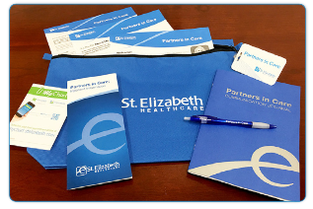
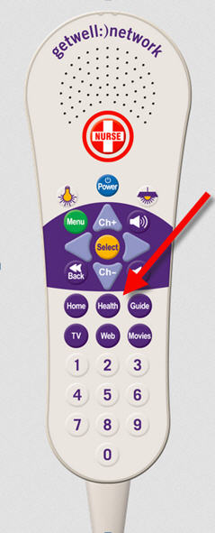
Putting It To Work
Patient Experience Team
Partners in Care Committee
Patient Interaction Solution
Looking at Epic’s Predictive Model Platform to make responses available.
Notes:
We have a number of programs in place to improve the patient experience and this compliments those programs
We have a team that focuses on Patient Experience and can use the high ranking predictors to understand what to concentrate on. For example, what emphasize in the newsletter, associate education and communication training.
We also have a Partners in Care Committee that focuses on developing a patient and family centered culture.
We also have a Patient Interaction system and we are looking as how we can improve the interactions. Especially the questions asked.

Slide 21

Lessons Learned
Predictors Vary By Organization
Detailed survey questions are relevant across organizations: Nursing Interaction & Teamwork, etc.
Epic In-Facility predictors vary.
Organization Change!
Don’t look back too far.
Recalibrate or rebuild models.
Predicting Is Challenging but Rewarding

Slide 22
Thanks!
jeff.gunderson@stelizabeth.com

